Slide 1
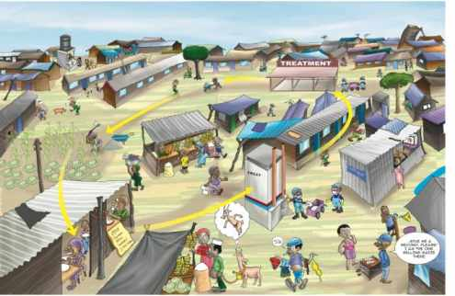
Water Sector Trust Fund
SOCIAL MARKETING
Concept Development
people, place, product, price, participation, promotion, policy, programs, positioning, partnerships, poo, pee

Slide 2
UBSUP Social Marketing: Concept development
What is social marketing?
“Social Marketing is the process of influencing human behavior on a large scale, using marketing principles for the purpose of societal benefit rather than commercial profit.” (Pamela Mae, 2001)
“The design, implementation and control of programs aimed at increasing the acceptability of a social idea, or practice in one or more groups of target adopters.” (Kotler and Zaltman, 1971).
Note: Social marketing programmes use data provided by the target audience to set promotional objectives
The “Ps” of social marketing people, place, product, price, participation, promotion, policy, programs, positioning, partnerships, pee (?), poo (?)

Slide 3
UBSUP Social Marketing: Concept development
Why Social MARKETING of better sanitation?
Although toilets are incentivised (Post Construction Incentive is offered), they will be sold to landlords, landladies and householders
UBSUP is a demand-driven programme!!
Social marketing aims to increase demand for better (SafiSan) toilets
There are different kinds of SafiSan toilets, people should get to know the differences between the toilets in (price, materials, etc.)
Sanitation is not always a priority of landlords and their tenants. This means that awareness creation is part of social marketing
People should know the risks related to poor sanitation and the importance of emptying, transport and treatment (the sanitation value chain); once more “awareness creation”

Slide 4
UBSUP Social Marketing: Concept development
The developement of UBSUP’s social marketing objectives, concept & tools was guided by:
An in-depth qualitative study in 5 towns
A quantitative study in 11 towns
MajiData
These studies:
  Gave us key information on what residents know, believe in, do and want
  Enabled us to identify and focus on specific target groups/categories
  Allowed us to identify the right media & develop messages that suit target audiences
  Helped us to prepare appropriate, attractive & motivating messages

Slide 5
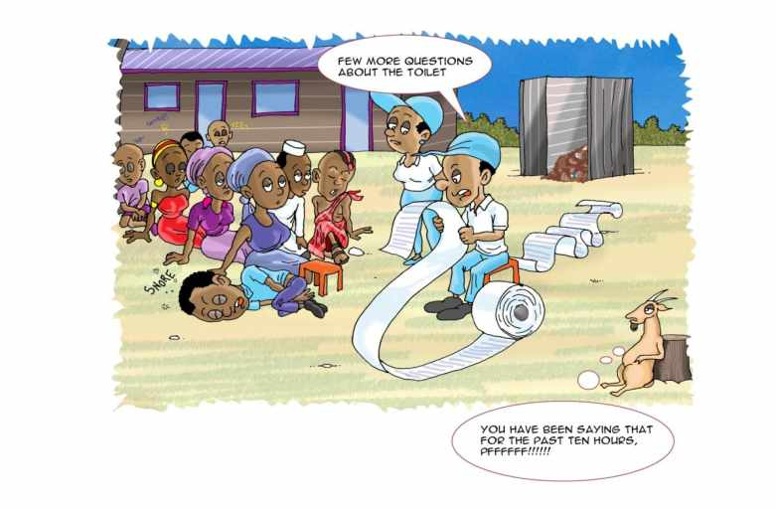
Thank You!

